Slide 1
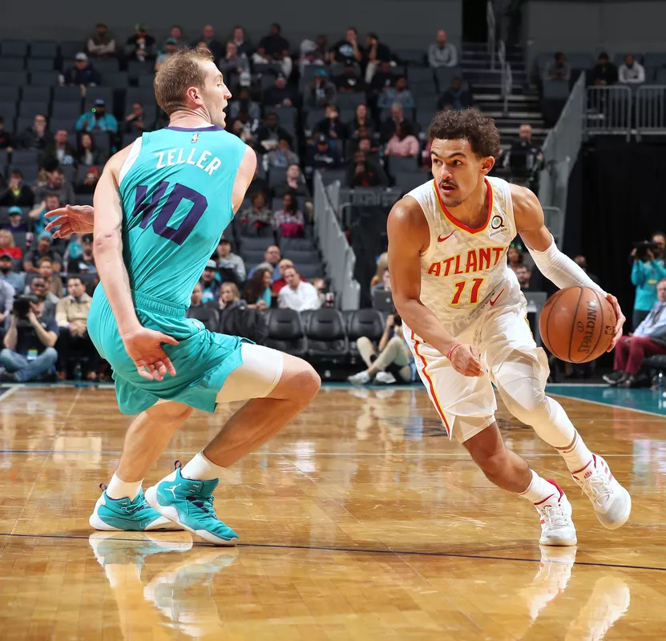
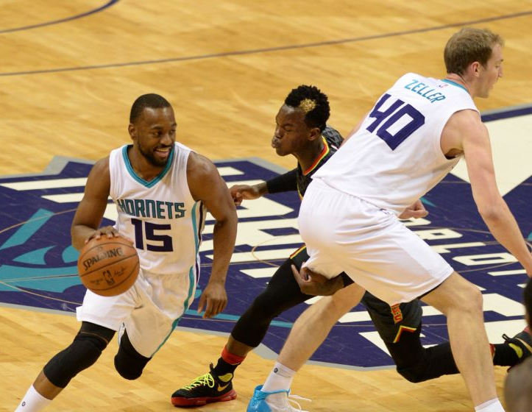
Summarizing a Basketball Game
Shraven Arimilli
Jake Haggard

Slide 2
Contents
Research Question and Problem Statement
Prior Work
Overview of Our Data
Our Approach
Model Evaluation
Project Contributions
Context
Problem statement

Slide 3
Research Question
and
Problem Statement

Slide 4

Problem Statement and Research Question
Problem Statement:
This has been solved before using more complex methods however we wanted to accomplish this task using methods discussed in our class.
The goal of this project is to find a way to have a computer summarize a sporting event. For our project we chose to summarize an Atlanta Hawks vs Charlotte Hornets NBA game.
Research Question:
How can we generate summaries of sporting events to help automate this task and can computers generate a summary that is considered similar to a summary written by a human?
ICompany
Context
Problem statement

Slide 5
Prior Work

Slide 6


Prior Work
LSTM vs. GRU vs. Bidirectional RNN for script generation
The research done in this paper opened up our eyes to the performance of GRUs and it influenced us to also include those in our model
Context Based Text-Generation Using LSTM Networks
This paper was beneficial because it gave us more insight on how to use RNNs along with LSTM networks to improve your model when compared to just using a RNN.
Generating Descriptions of Entity Relationships
The technique used in this paper to generate text was Data-To-Text.
The two main issues faced in this paper were having to understand the structured data and generate associated descriptions.
The model in this paper mentions how it used Attention and as well as a LSTM in the architecture of their model to generate text.
Goes into detail about the BLEU metric
ICompany
Context
Problem statement

Slide 7
Our Approach

Slide 8

Our Approach
Load Data
Data Pre - Processing
Train the Model
Generate a Summary

Slide 9
Our Approach: Load Data
The dataset we used for this project was the Rotowire dataset
Our data consisted of information about every NBA game from 2014 to 2017
This gave us 4.8k entities of NBA Games for our data
An Example of an Authentic Summary:
Following a week filled with trade rumors , Paul George came out of the All-Star break in fairly unimpressive fashion . In his first four games following the break , George shot a combined 16 - of - 54 ( 29 percent ) from the field and was averaging just 14 points per game over that stretch . However , in his last two games , George has flipped the script entirely and rattled off a pair of incredible offensive performances . Following Monday 's 36 - point performance in the Pacers ' loss to the Hornets , George has now scored a combined 70 points over his last two games and did so while shooting a scorching 27 - of - 44 ( 61 percent ) from the field and 12 - of - 23 ( 52 percent ) from behind the arc . The performances from George on Sunday and Monday were by far his best back - to - back shooting and scoring performances of the season .

Slide 10
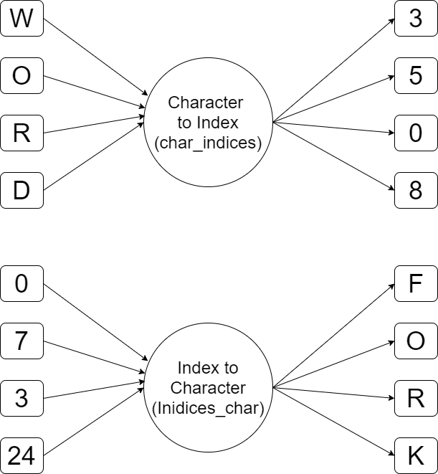
Our Approach: Data Pre - Processing
A dictionary was created for each team to store information relevant for each team
Create a corpus containing the appropriate teams
Created a mapping from characters to indexes and indexes to characters
Indexes are represented in integer form
Removed some punctuation
Lemmatized our data

Slide 11
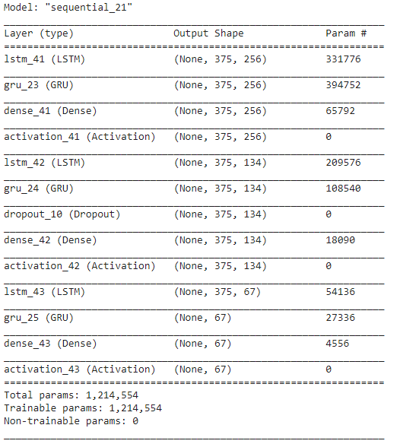
Our Approach: Train the Model
ICompany
We used a RNN+LSTM architecture for our model
The model also multiple LSTM layers
GRU layers were not a part of our original model’s architecture but helped increase performance
The Dropout layer has a value of 0.5
We used Softmax as our Activation Function
The Adam Algorithm was used to optimize our model
Context

Slide 12
Our Approach: Train the Model
ICompany
We trained our model for 2 epochs
The size of each batch was 350 units
Text Diversity was given a value of 0.15
We had a step size of 2
A window size of 350 characters
The range for potential starting points was decreased to [0, ((length of the corpus) - (average length of a summary) - 1)]
Context

Slide 13
Our Approach: Generate a Summary
To model uses the window size value decide how big the splits are when it has to split the data into partitions while the it is training
The model samples an ‘index’ and uses that to generate a probability as its probability.
The model uses the given probability to generate an index that it thinks fits the summary, the index is then converted to a character and added to the summary.
Generated Summaries:
Marvin Williams was only able to muster eight points , he did haul in 11 rebounds and dished out three assists . The Hawks head to New York for a Sunday afternoon date with the Knicks , while the Hornets head to New Orleans to take on the Pelicans on Saturday night . The Charlotte Hornets defeated t
ff the bench for Charlotte , as he poured in 19 points and went 8 - for - 8 from the free - throw line . With center Al Jefferson ( meniscus ) still out , Cody Zeller was able to shine in his starting role , posting a 19 - point , 10 - rebound double - double along with three blocks . The Hornets s

Slide 14
Model Evaluation

Slide 15
Model Evaluation - The Metrics Used
B.L.E.U.:
BLEU(BiLingual Evaluation Understudy) is a metric used to check the accuracy of machine generated text from one natural language to another. The quality of the BLEU is determined by how well it performed “is the generated text close to human speech”. Pros to this technique is that it is widely used and an inexpensive technique when it comes to metrics. The exact BLEU score being used is the `corpus_bleu` metric.
R.O.U.G.E.:
R.O.U.G.E. (Recall Oriented Understanding for Gisting Evaluations) is a metric that is commonly used in the realm of NLP. ROUGE provides a set of metrics within it, Precision, Recall and FMeasure. Similarly to B.L.E.U, R.O.U.G.E. is also used to compare machine generated text to another piece of text. When evualting our model we used the `rougeLsum` metric since we are comparing the entire generated summary to an entire human written summary.
ICompany
Context
Problem statement

Slide 16
The Model’s Results - Model Performance
Baseline Model
Generated Summary:
- foot three - pointer with 22 seconds remaining to extend San Antonio 's advantage to 115 - 110 . Davis Bertans paced the bench with 11 points . Kemba Walker led the Hornets with 26 points and supplemented them with nine rebounds and seven assists . Nicolas Batum was next with 13 points , seven rebounds and five assists . Roy Hibbert , Michael Kidd-Gilchrist and Marvin ….
Metrics/Results:
BLEU: 7.9857408e⁻²³²
ROUGE - Precision: 0.1185932731
ROUGE - Recall: 0.0961491163
ROUGE - FMeasure: 0.1038450691
Final Model (V 2.5)
Generated Summary:
Marvin Williams was only able to muster eight points , he did haul in 11 rebounds and dished out three assists . The Hawks head to New York for a Sunday afternoon date with the Knicks , while the Hornets head to New Orleans to take on the Pelicans on Saturday night . The Charlotte Hornets defeated t
Metrics/Results:
BLEU: 0.386253268
ROUGE - Precision: 0.4820477367
ROUGE - Recall: 0.1066263334
ROUGE - FMeasure: 0.1723767459
Context
Problem statement

Slide 17
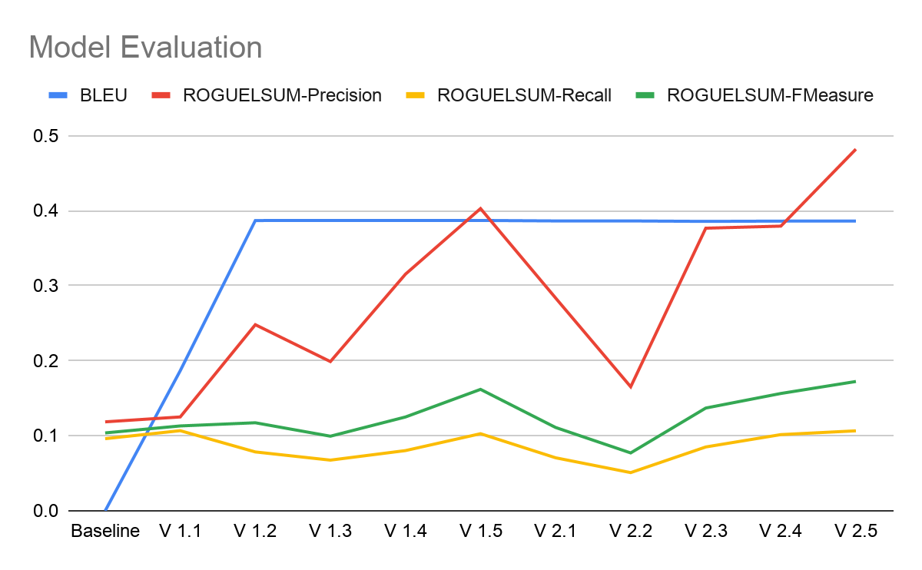
Model Evaluation - Metric Scores Over Time
ICompany
Context

Slide 18
Model Evaluation - Modifications Made to the Model
Model Modifications:
Implemented multiple LSTM layers
Added a Dropout with a probability of 0.5
Added a GRU layer for every LSTM layer
Increased the number of Dense layers
Changed the optimizer to use the Adam algorithm instead of the RMSprop algorithm used in the baseline
Hyperparameter Modifications:
Decreased the length of generated summaries to 300
Change the diversity of the generated text to 0.25
Changed the window to a value of 350
Diminished the range for the starting point of the text generation
ICompany
Context
Problem statement

Slide 19
The Observations About The Model We Made
ICompany
Context
Problem statement
Observations:
The largest improvements were implementing multiple LSTM layers and adjusting value of the Dropout layer to 0.5
Text diversity values greater than 0.35 generated gibberish and values smaller than 0.1 generated repetitive summaries.
Having more than 2 epochs did barely improved performance in some cases and in other cases it caused our model to have a decreased performance.
Like the number of epochs, altering the value for the batch size had to little to no impact on the model’s performance.
Window sizes that were too small created the same exact summary multiple times with little to no variation
When summaries generated had over three hundred characters it caused the model to generate more white space than text after generating about three hundred characters.

Slide 20
Project Contributions

Slide 21
Project Contributions
Jake’s Contributions:
Exploratory Data Analysis
Assisted in Creating the Base Model
Designed and Implemented the Updated Architecture of the Model
Altered the Model’s Hyperparameters
Shraven’s Contributions:
Performed the Data Pre Processing
Assisted in Creating the Base Model
Selected Evaluation Metrics and Evaluated the Model
Worked on Presentation
Context
Problem statement

Slide 22
The End.

